Slide 1
Design Presentation: Security
Owner: Sean Norman
CSA07P | 1 of 2
Session Day/Time: |  | Presenters/SMEs:
Virtual Format and Software:
Cohort / Breakout Mgmt
Objective of Session: | As a result of attending this, attendees will better be able to…
Existing Sources: | <link to any supporting content sources (if any)>
Learner Content: | <Link to draft ppt slide deck and any other materials that the attendees would be seeing or using as part of this session>
Presenter/ SME Guide Content: | <Link to any supporting materials that are just for the presenter and/or supporting SMEs>
Required Homework + name of session for HW review: | No homework or pre-required content needed for this session

Slide 2
Design Presentation: Security
Owner: Sean Norman
CSA07P | 2 of 2
Session Flow and Detailed Agenda |  | Presenter/SME: | Time
Prework | No attendee pre-work needed for this session | N/A | N/A
Session Introduction | Set context for when this process takes place | <presenter> | 3 mins
Body of the session / discussion, activities, Q&A... |  | <presenter> | 25 mins
Session Closing / Homework |  | <presenter> | 2 mins

Slide 3
Topics Covered
Security Secure a database in Azure Synapse
Advanced data security
Auditing
Network security
Authentication
Access control
Data protection

Slide 4
Security in Azure Synapse

Slide 5

Agenda
1 Security baseline
Synapse Analytics security baseline
2 Network security
Synapse Managed Virtual Network and Managed private endpoints

Slide 6
Security baseline for Synapse Analytics

Slide 7
The Security Baseline for Synapse Analytics
Contains recommendations that will help you improve the security posture of your deployment
Network security | Protect with VNETs Monitor configuration and traffic of VNETs, subnets and network interfaces Use Advanced Threat Protection (ATP) and DDoS Protection, Record network packets, Use tags for network security groups
Logging and monitoring | Update time synchronization for your compute deployments, Central security log management, Enable auditing on the Azure SQL server-level, Configure security log storage retention, Use advanced Threat Protection (ATP) for Azure SQL Database in conjunction with Azure Security Center to monitor and alert on anomalous activity
Identity and access control
Data protection
Notes:
https://docs.microsoft.com/en-us/azure/synapse-analytics/security-baseline

Slide 8
Security Baseline for Synapse Analytics
Contains recommendations that will help you improve the security posture of your deployment
Vulnerability management
Inventory and asset management
Secure configuration
Malware defense
Data recovery
Incident response
Penetration tests and red team exercises
Notes:
https://docs.microsoft.com/en-us/azure/synapse-analytics/security-baseline

Slide 9
Network Security in Synapse

Slide 10
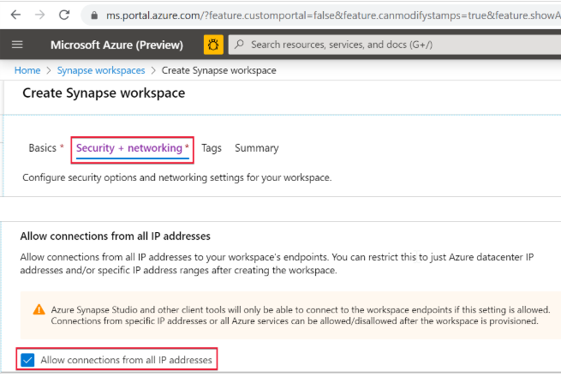
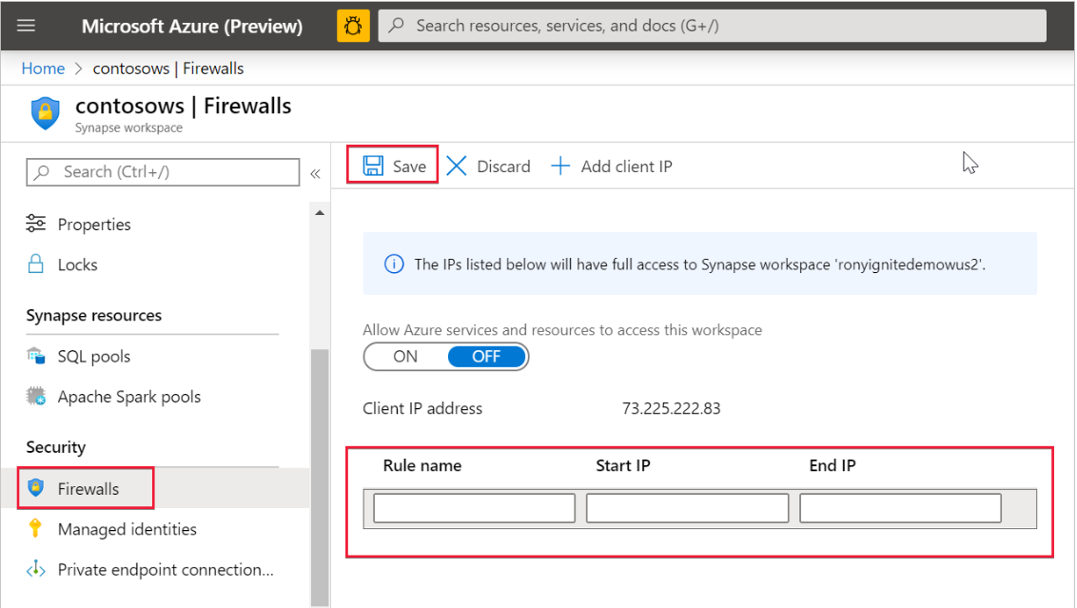
Synapse Workspace IP firewall rules
Select Security + networking and check Allow connections from all IP addresses during workspace creation
OR
(after the workspace is created)
Select Firewalls under Security from Azure portal. To add a new IP firewall rule, give it a name, Start IP, and End IP. Select Save when done

Slide 11
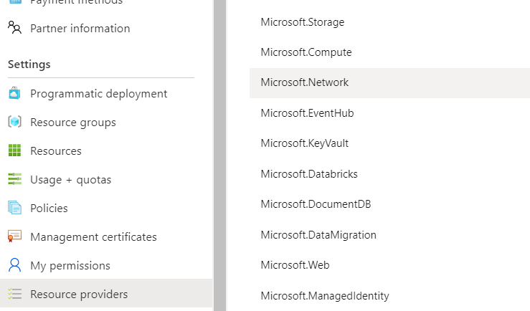
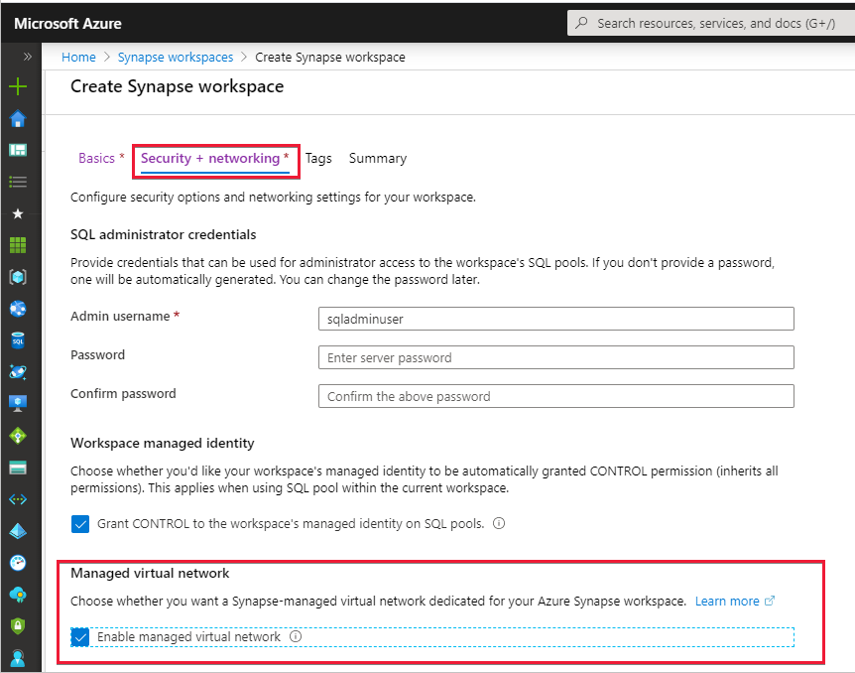
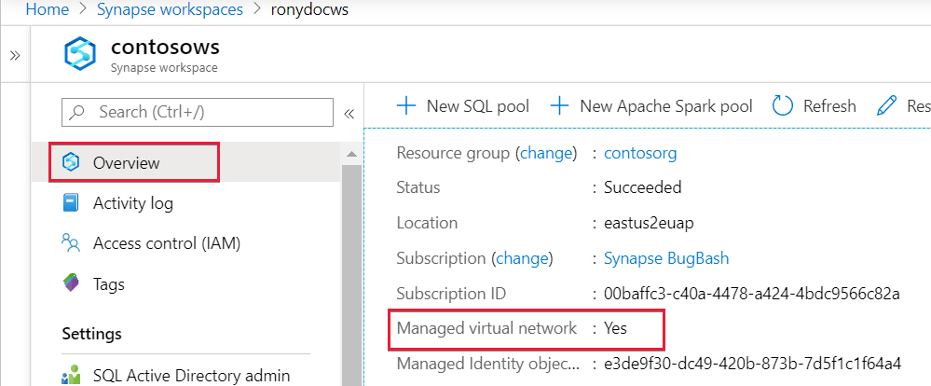
Create an Azure Synapse workspace with a Managed workspace Virtual Network
1. Register the Network resource provider on the subscription: All services: subscription -> select Subscriptions ->select Resource providers -> Microsoft.Network -> Register
(powershell:Register-AzResourceProvider -ProviderNamespace Microsoft.Network)
2. Create a Synapse workspace and Enable Managed Virtual Network
3. Check settings
Notes:
A Managed workspace VNet within Azure Synapse Analytics can only be deployed when you create the Azure Synapse workspace.
When you create your Azure Synapse workspace, you can choose to associate it to a VNet. The VNet associated with your workspace is managed by Azure Synapse. This VNet is called a Managed workspace Vnet.
Benefits
With a Managed workspace Virtual Network you can offload the burden of managing the Virtual Network to Azure Synapse.
You don't have to configure inbound NSG rules on your own Virtual Networks to allow Azure Synapse management traffic to enter your Virtual Network. Misconfiguration of these NSG rules causes service disruption for customers.
You don't need to create a subnet for your Spark clusters based on peak load.
Managed workspace Virtual Network along with Managed private endpoints protects against data exfiltration. You can only create Managed private endpoints in a workspace that has a Managed workspace Virtual Network associated with it.

Slide 12
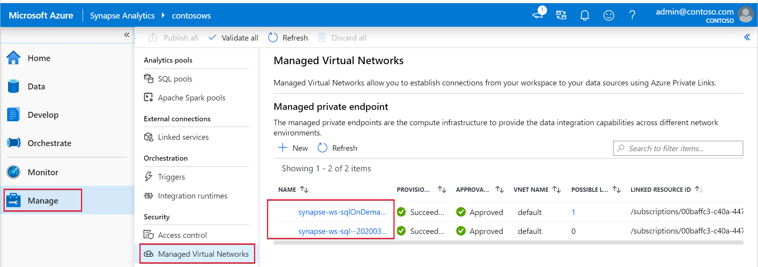
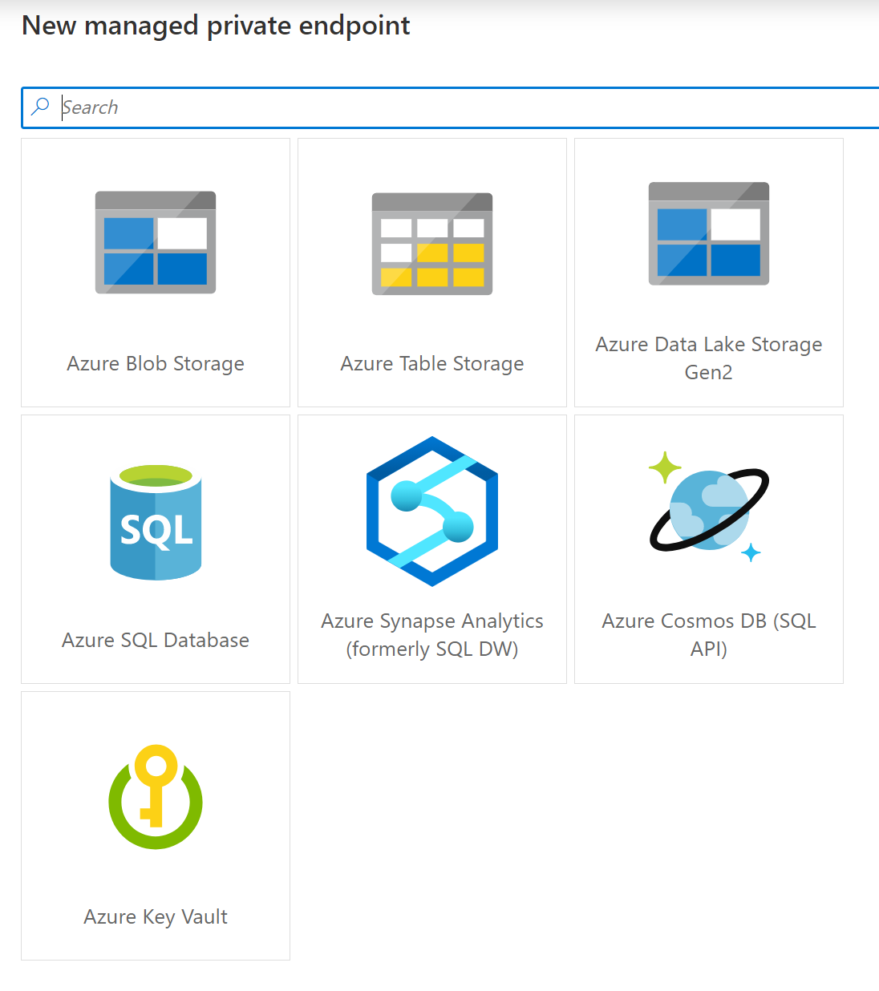
Managed private endpoints for SQL pool and SQL on-demand and other data sources
In the Studio, select Manage in the left navigation, then select Managed Virtual Networks to see the list of managed private endpoints or to add an endpoint to other data sources .
When a workspace is created, Azure Synapse automatically creates two Managed private endpoints to SQL pool and SQL on-demand in that workspace.
Notes:
Managed private endpoints are private endpoints created in the Managed workspace Microsoft Azure Virtual Network establishing a private link to Azure resources. Azure Synapse manages these private endpoints on your behalf.
Only supported in Azure Synapse workspaces with a Managed workspace Virtual Network
Initially created in a “Pending” state in Azure Synapse, initiates an approval workflow, and can be approved/rejected by the Private link resource owner.
Only a Managed private endpoint in an approved state can send traffic to a given private link resource.

Slide 13


Manage VNets in Synapse Workspace
The two Managed private endpoints to SQL pool and SQL on-demand automatically created in Synapse when the Managed workspace VNet is deployed.
Synapse Workspace
Managed VNet
Managed
private endpoint to SQL on-demand
Workspace
SQL on-demand
Synapse Studio
Managed
private endpoint to SQL Pool
Workspace
SQL Pool
Managed private endpoint
Spark Clusters
Other data sources
that support Private Link
(e.g. Cosmos DB,
Azure Storage, ADLS etc.)
The private endpoint establishes a private link between your
Azure Synapse Analytics workspace and your data sources where traffic between your VNet and workspace traverses entirely over the Microsoft backbone network.
IMPORTANT
All outbound traffic from the Managed workspace VNet will be blocked in the future. It's recommended that you connect to all your data sources using Managed private endpoints.
Internet

Slide 14
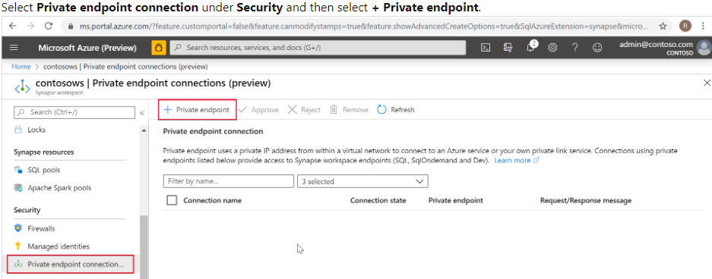

Connecting to Synapse from On-Premise
On-Premise VNet
Synapse Workspace
SQL on-demand tenant
Managed VNet
*.sql.azuresynapse.net
Managed private endpoint to SQL on-demand
SQL Pool tenant
*-ondemand.sql.azuresynapse.net
Managed PE to SQL Pool
Dev tenant
*.dev.sql.azuresynapse.net
Azure VNET
Subnet
VPN Gateway
Private endpoint
Private endpoint
Private endpoint
site-to-site
point-to-site
Notes:
Check this article to learn how to create private endpoins to your Azure Synapse workspace: https://docs.microsoft.com/en-us/azure/synapse-analytics/security/how-to-connect-to-workspace-with-private-links

Slide 15
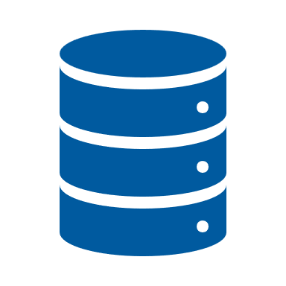
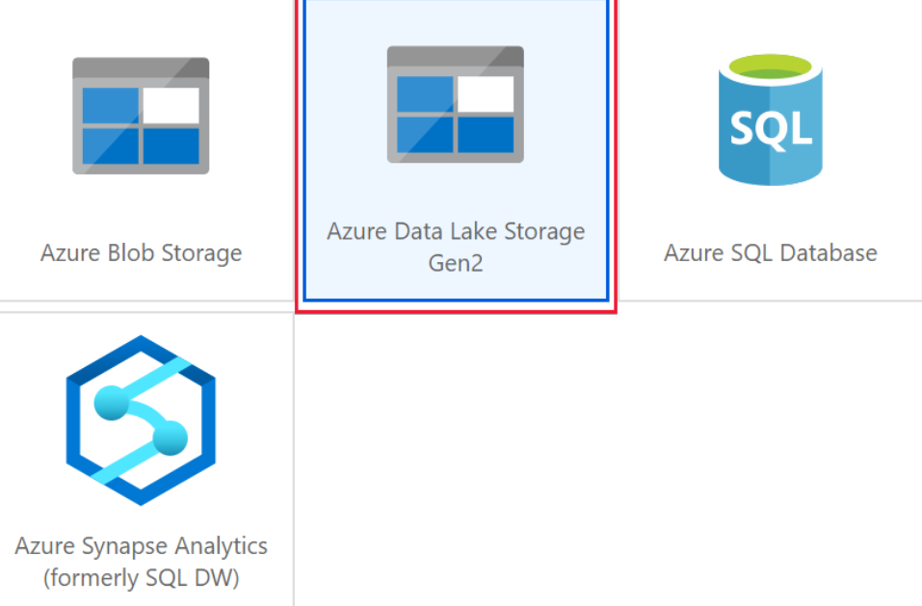
Self-hosted Integration Runtime in Synapse Workspace
Azure Data Factory
*.frontend.clouddatahub.net
Azure ServiceBus
*.servicebus.windows.net
Optional, required when using the staged copy feature
Self-hosted Integration Runtime
(on-premise)
Azure Storage
*.core.windows.net
Optional, required when the Self-hosted integration runtime has auto-update enabled
443
download.microsoft.com
Synapse Workspace
Azure
Integration Runtime
Self-Hosted
Integration Runtime
Managed VNET
Workspace
SQL on-demand endpoint
Synapse Studio
Private endpoint to SQL on-demand
Private endpoint to SQL Pool
Workspace
SQL Pool
endpoint
Private endpoint
Spark Clusters
Supports up to 4 nodes for high availability and scalability
Other data sources
that support Private Link
(e.g. Cosmos DB, Azure Storage etc.)
Internet

Slide 16
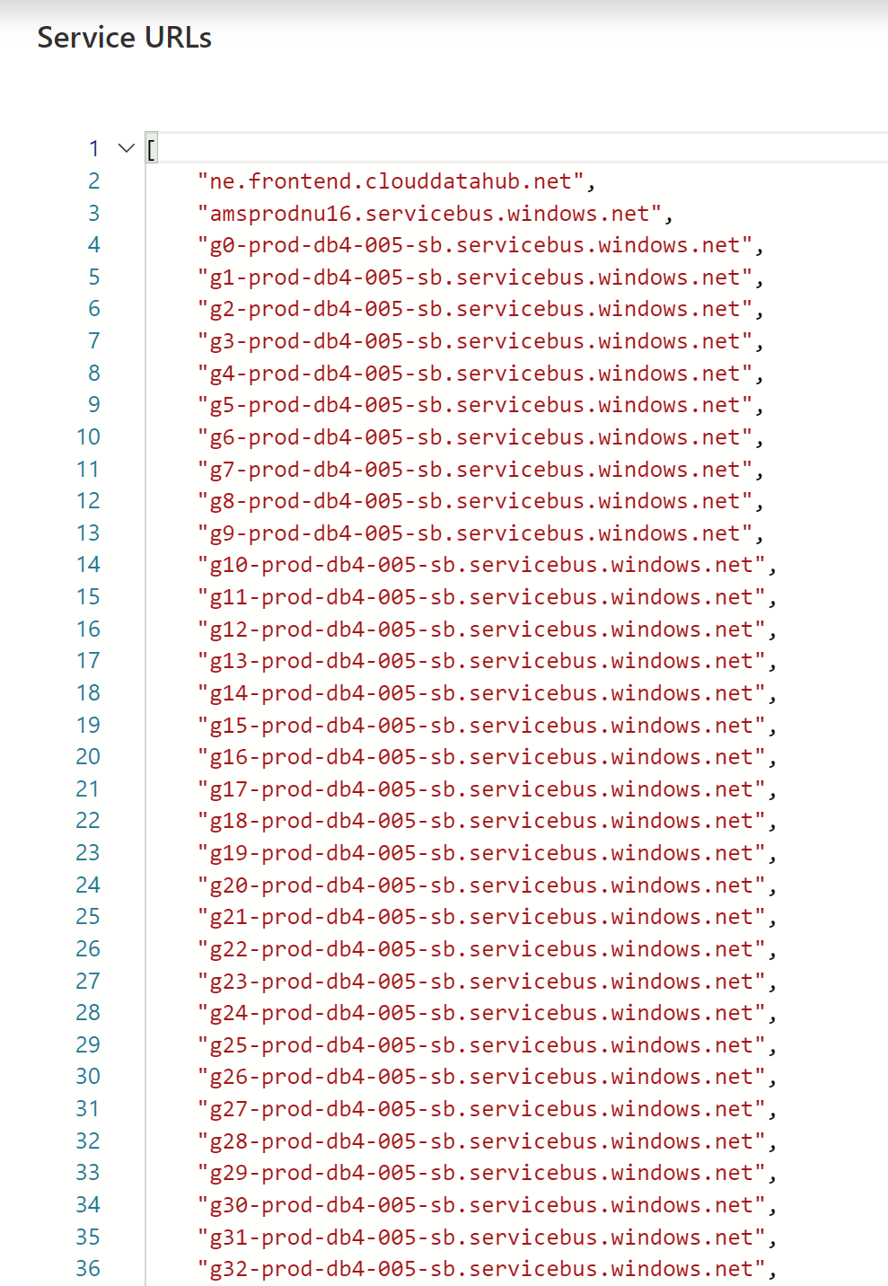
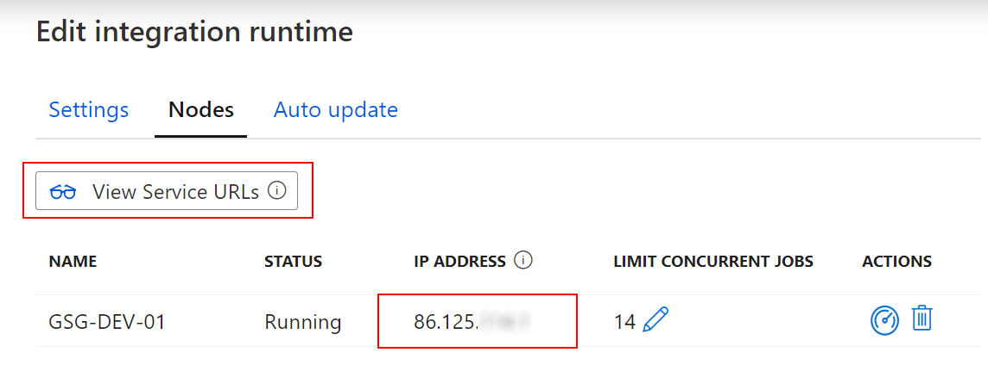
Self-hosted Integration Runtime in Synapse Workspace
Whitelisting of specific public Azure endpoints
Whitelisting of IR-specific IP addresses

Slide 17
Thank You slide
Thank you

